Slide 1
The Scrum-Agile Approach
A Summary of the Scrum-Agile Mechanics and Methodologies

Slide 2
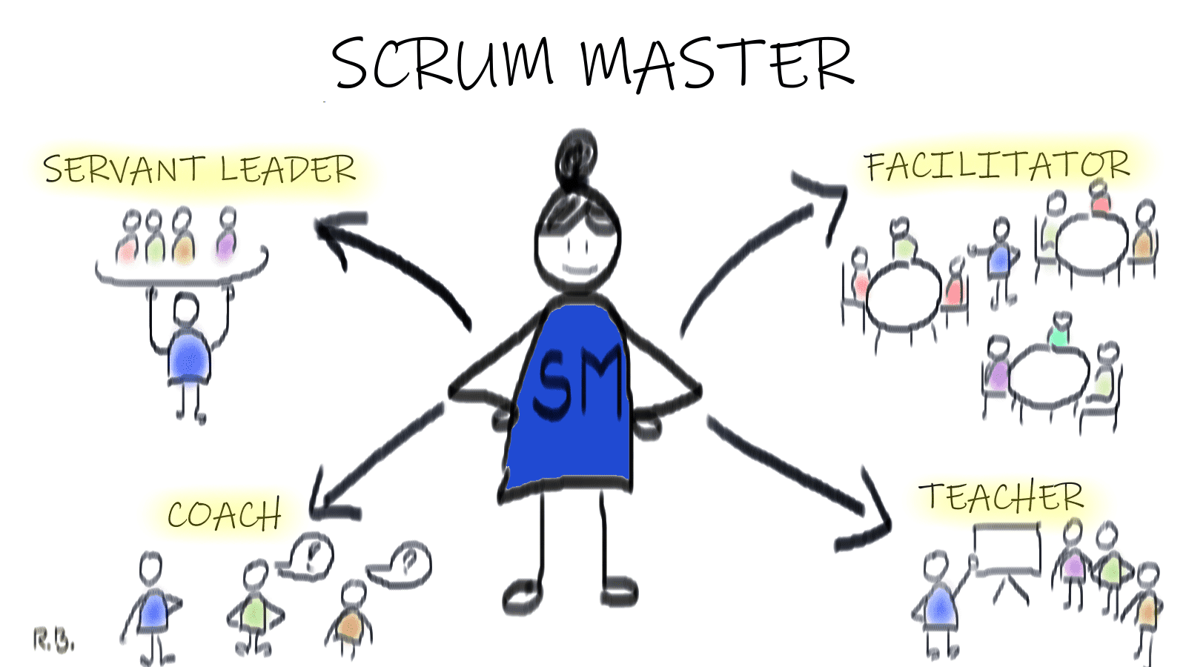
Meet the Scrum-Agile Team: The Scrum Master
Facilitates the daily scrum; A quick meeting every day to organize daily tasks and team members.
Coaches team members to be cross-functional and self-managing.
Removes impediments of tasks for time efficiency as the daily tasks change.
Works with the Product Owner to define an effective product goal and manage incoming user/stakeholder information.
Works with Product Owner to establish effective product planning based on the priority of daily tasks.

Slide 3
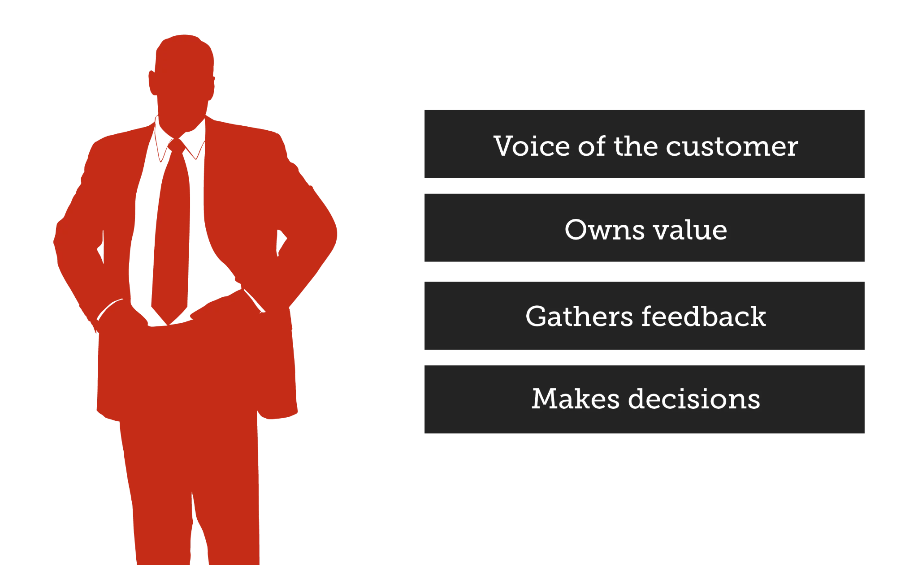
Meet the Scrum-Agile Team: The Product Owner
Brings in external information important to project development like user stories and stakeholder changes.
Responsible for the work done on the project and value delivered.
Clearly communicates the team’s goals, project vision, goals and objectives.
Works with the Scrum Master to integrate said goals and objectives into the daily tasks for the team members.
Maintains accuracy of the product backlog

Slide 4

Meet the Scrum-Agile Team: Development Team
Help with setting goals and objectives for the sprint cycle.
Implement best practices for finding data to improve the product and development process.
Clearly and honestly communicate ideas for daily tasks and concerns in areas of limited efficiency.
Integrate ideas from user stories into the project based on priority.
Test software and provide feedback on changes to the product.

Slide 5
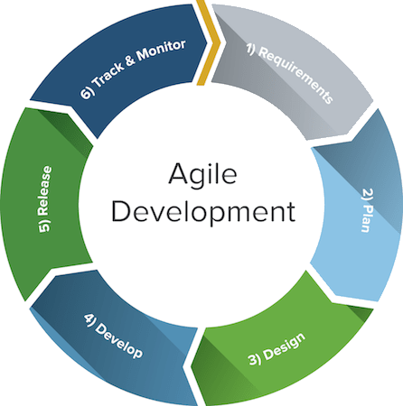
The Software Development Lifecycle
Planning: Collaborate with stakeholders to define project requirements, set goals, and prioritize tasks to be completed in each cycle.
Design: Design software architecture, define user stories, and create a theoretical roadmap for the product.
Development: Coding of software begins. Development is broken down into smaller sprint cycles, each one focusing on a different increment of the product.

Slide 6
The Software Development Lifecycle
Testing: Incrementally test the product to ensure that it meets the accepted criteria from the planning phase.
Deployment: The product is deployed into the production environment after being tested and approved by stakeholders.
Maintenance: The team provides support, fixes bugs and makes necessary changes to the product based on user feedback.

Slide 7
SDLC: Agile vs Waterfall
Waterfall
Agile
Description
1
Requirements
Clearly- defined
Can change
Waterfall relies on a clearly defined goal and abides by it until the end of the cycle, regardless of environmental changes, but agile’s goal can change and flex.
2
Client Involvement
Waterfall does not traditionally utilize client input. Agile involves client input via user stories and testing.
3
Type
Straightforward solutions
Complex projects
Waterfall’s rigidity is better suited for projects with a clearly defined plan and goal. Agile is better suited for complex projects with more unknowns that could potentially change the project.
4
Time Domain
Strict
Loose
Waterfall’s time domain is usually set in the planning phase. Agile’s time domain can change based on product requirements, to which the agile team is prepared for.
5
Team Collaboration
Moderate
Intensive
Waterfall does not usually involve collaboration between parties from different phases. Agile team members collaborate regardless of status or title. Scrum master, product owner and developers collaborate in all different permutations.

Slide 8

Agile or Waterfall: What to Consider?
How well does your team communicate?
How much effort does it take for your team to meet on a daily basis, even for a short time?
Who is involved in the short-term decision-making processes?
How well does your team react to sudan changes in plans, both on a group level and individual level?
All of the questions above need to be considered when choosing an agile approach. Your team must be comfortable being modular in its’ decision making. If your team meets these requirements, then the agile approach is suitable for use and team training.

Slide 9
References
Barrell, D. (2019). Accessibility in agile team practices [Photograph]. https://www.deque.com/blog/accessibility-in-agile-team-practices/
Blicharz, R. (2020). Scrum roles #3 scrum master [Photograph]. https://letsscrumit.com/scrum-roles-3-scrum-master
Bowes, J. (2014). Scrum roles: The product owner [Photograph]. https://manifesto.co.uk/scrum-roles-product-owner/
Harris, J. (2021). The software development lifecycle [Photograph]. https://www.linkedin.com/pulse/software-development-life-cycle-sdlc-tutorial-richard-harris

